Slide 1
Accounting and Financials
Barringer Chapter 8
Notes:
https://www.youtube.com/watch?v=opNiKBP7hQo https://www.youtube.com/watch?v=1gg2vXq-1VI 2"00 Paul Graham https://www.youtube.com/watch?v=2lcp0uZsY7k

Slide 2
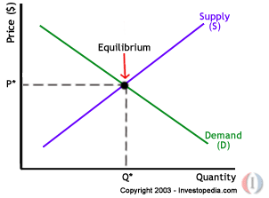
AREC 213 Lecture 6
Pricing Your Product
How much Should you Charge
You must cover your costs
People must be willing to pay
High or low price you must provide Value to your customer.
No matter what strategy you employ to determine your price, you always know all your costs
http://www.kptv.com/story/36534090/avocado-prices-on-the-rise?utm_source=facebook&utm_medium=meredithHub
Meanwhile, inelastic demand can be represented with a much steeper curve: large changes in price barely affect the quantity demanded. Elasticity of supply works similarly. If a change in price results in a big change in the amount supplied, the supply curve appears flatter and is considered elastic.
Notes:
Go over lines and slopes

Slide 3

AREC 213 Lecture 6
Pricing Your Product
You can only spend money you have built into your price
Discounts, coupons, rebates, loyalty programs all need to be considered when setting your price
Your Price Must allow you to cover all costs and ideally be able to make a profit (net income)
Value is what your customer believes your product is worth
Price is the amount of money you charge your customers per sales unit of your product

Slide 4
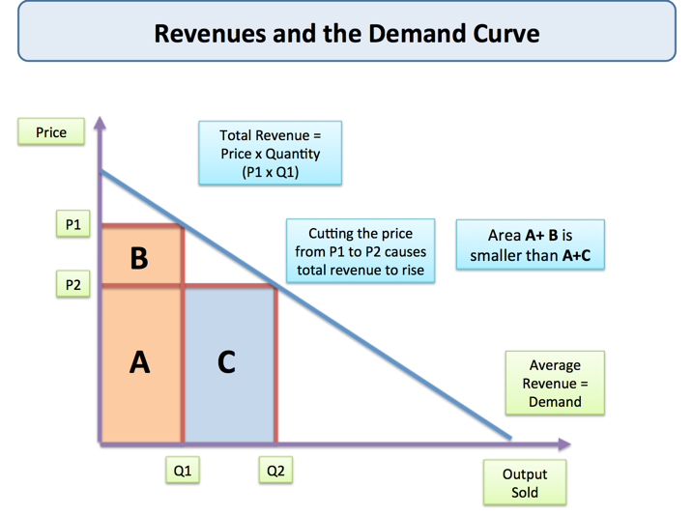
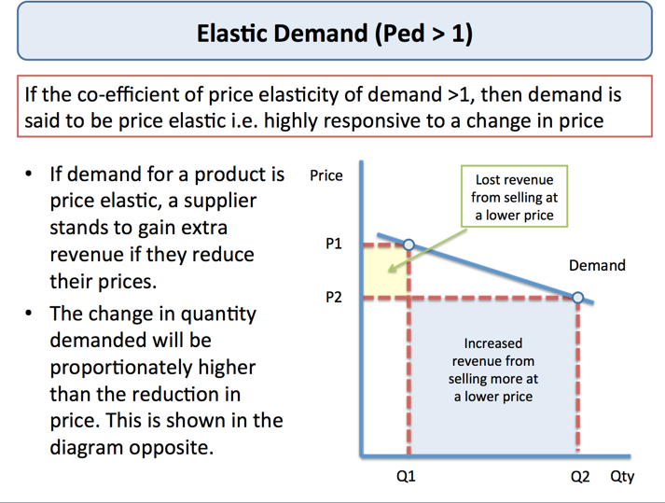
AREC 213 Lecture 6
`
Total Revenue
Your Profit it is equal to what you sell times the price of what you sell
Net Profit
Is how much is left after every expense has been paid

Slide 5
AREC 213 Lecture 6
Variable Costs
Are costs that go up or down in relation to sales volume.
Example: flour to make bread
Example: You sell personalized T-shirts for $10.00 each
Selling Price $10.00
Variable Costs:
Raw material (t-shirt) $ 3.00
Hourly labor $ 1.00
Sales commission $ 1.00
Shipping charge $ .50
Total Variable Costs $ 5.50
Price minus Variable Costs $ 4.50
The $4.50 is called the Gross Profit and it represents how much each unit of sales “contributes” towards paying for fixed costs, selling expenses, administrative expenses, and profits.

Slide 6
AREC 213 Lecture 6
Fixed Costs
Costs that don’t change regardless of sales volume
Example: Rent
Fixed Expenses per Month
Rent $ 800.00
Telephone $ 100.00
Insurance $ 50.00
Bookkeeping $ 100.00
Loan Payment $ 300.00
Total Fixed Costs $ 1,350.00

Slide 7
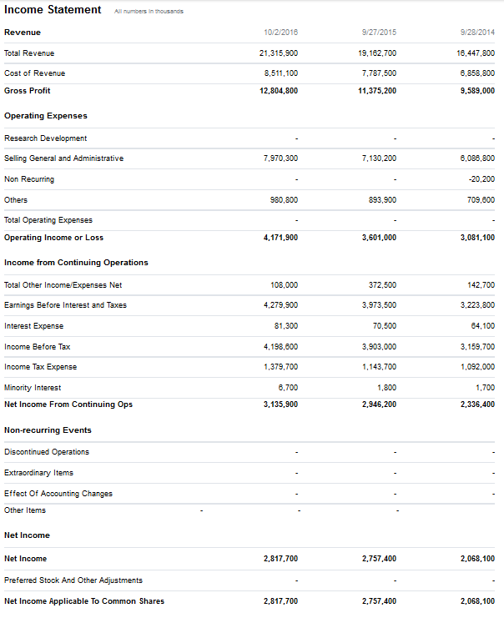
AREC 213 Lecture 6
Accounting
Income Statement
Balance Sheet
Statement of Cash Flows

Slide 8
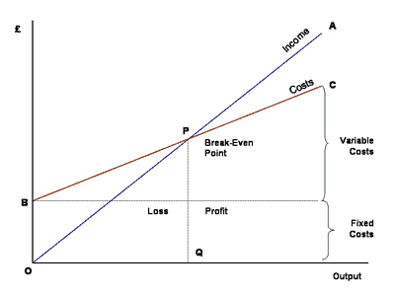
AREC 213 Lecture 6
Break Even Analysis
Break Even is the total sales volume at which the business covers all of its expenses with nothing left over.
This can be measured in the number of units sold or in the total dollar amount of sales.
Break Even is a critical milestone on your Path to Profit
Fixed Costs (FC) | Variable Costs (VC) | Total Costs | Break Even Unit Sales | Total Revenue
$150,000 | $122,093 | $272,093 | 140 | $272,093
$250,000 | $203,488 | $453,488 | 233 | $453,488
$500,000 | $406,977 | $906,977 | 465 | $906,977
$1,000,000 | $813,953 | $1,813,953 | 930 | $1,813,953
$1,500,000 | $1,220,930 | $2,720,930 | 1395 | $2,720,930
$2,500,000 | $2,034,884 | $4,534,884 | 2326 | $4,534,884
$5,000,000 | $4,069,767 | $9,069,767 | 4651 | $9,069,767
Break Even Point = Fixed Costs ÷ (Price - Variable Costs)

